Slide 1
Transfer Learning
Oran Nahum

Slide 2
Transfer Learning
Good labeled data is hard to get
+
Models require a lot of data
=
Biggest issue in ML

Slide 3
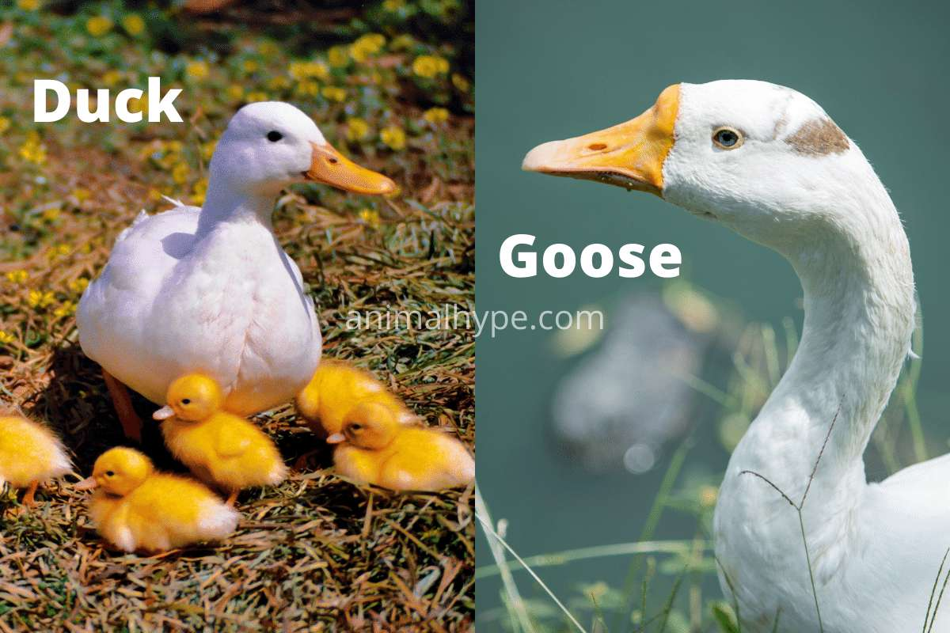
Transfer Learning
How do humans learn over little data?
Notes:
goose=אווז
Duck=ברווז Ducks have broad, flat bill Geese have shorter, notched bill

Slide 4
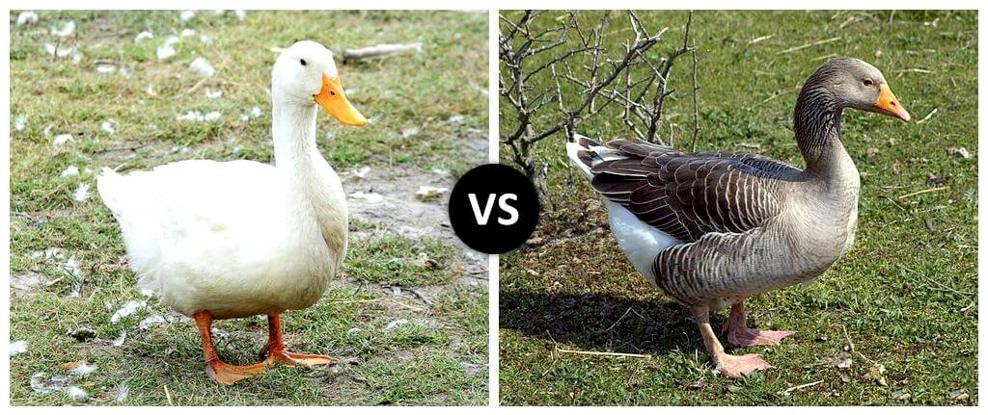
Transfer Learning
How do humans learn over little data?
Notes:
goose=אווז
Duck=ברווז Ducks have broad, flat bill Geese have shorter, notched bill

Slide 5
Transfer Learning
How do humans learn over little data?
They generalize from other problems
By discovering & reusing useful features
Can models do the same?
Notes:
goose=אווז
Duck=ברווז Ducks have broad, flat bill Geese have shorter, notched bill

Slide 6
Embeddings
An embedding is a relatively low-dimensional space into which you can translate high-dimensional vectors.
Embeddings make it easier to do machine learning on large inputs like sparse vectors representing words.
Ideally, an embedding captures some of the semantics of the input by placing semantically similar inputs close together in the embedding space.
An embedding can be learned and reused across models.
Notes:
goose=אווז
Duck=ברווז Ducks have broad, flat bill Geese have shorter, notched bill

Slide 7
Embeddings
How to create an embedding:
Training a model on a task with lots of data
Remove the top layer[s] of the model (usually softmax)
[Optional] Fine tune the embedding on more relevant data
Output
Embedding
Input
Image
Notes:
goose=אווז
Duck=ברווז Ducks have broad, flat bill Geese have shorter, notched bill

Slide 8
Embeddings
How to create an embedding:
Training a model on a task with lots of data
Remove the top layer[s] of the model (usually softmax)
[Optional] Fine tune the embedding on more relevant data
Output
My Output
Embedding
Input
Image
Notes:
goose=אווז
Duck=ברווז Ducks have broad, flat bill Geese have shorter, notched bill

Slide 9
Embeddings
How to create an embedding:
Training a model on a task with lots of data
Remove the top layer[s] of the model (usually softmax)
[Optional] Fine tune the embedding on more relevant data
Since training is expensive and time consuming, it is common to reuse famous models
Notes:
goose=אווז
Duck=ברווז Ducks have broad, flat bill Geese have shorter, notched bill

Slide 10
Tensorflow Hub
A central hub for tensorflow pretrained models
Notes:
goose=אווז
Duck=ברווז Ducks have broad, flat bill Geese have shorter, notched bill

Slide 11
Gotchas
Model work on images of a specific size; yours won’t have the same size
Look for “keras resize layer”
Embeddings are large - there’s high chance of overfitting
Regularization is your friend! Dropout in particular

Slide 12
Troubleshooting
My model is getting low accuracy on training data!
Do you have at least one hidden layer? Is it large enough?
My loss curve is linear!
Try raising the learning rate
My loss curve is jaggy!
Try reducing the learning rate
My training accuracy is great, but validation/test accuracy isn’t
You’re overfit - try using regularization

